Slide 1
Towards sustainable consumption of automobility
SCORAI 2016
Paul Nieuwenhuis

Slide 2
Many environmentalists advocate consuming less? The problem is…
We use our things to express who we are:
To create our place in society
To show how successful we are
To show what tribe or group we belong to
So, taking away our things means taking away a large part of our selves.

Slide 3
We like things…
And yet, we throw a lot of them away.
Our relationship with things is a key element in our unsustainability;
To understand this we need to explore our relationship with all the stuff on our planet…

Slide 4
Waste is a relationship issue
“waste is nothing more than symptomatic of a failed user/object relationship, where insufficient empathy led to the perfunctory dumping of one by the other.”
(Chapman, 2005, p20)

Slide 5
Erazim Kohak (1985, 35-36)
“Artifacts are not only products, but also gifts... Their being has been bought at a price,… of animals slaughtered, trees felled, ore mined…
A gift, though, requires gratitude as a response. It is surely one of the most elementary prima facie obligations to treat a gift with respect…Though it might be my privilege to use that resource, that gift, it is immoral for me to waste it.”

Slide 6
But what about economic growth?
“Degrowth theorists call for ‘an exit from the economy’…However, proposing alternative economic models is not enough. We must also question the existence of an autonomous sphere called ‘the economy’…”
(Giorgos Kallis’ submission to The Great Transition Debate, 2015)

Slide 7
This reminded me of…
“Two views of the world dominate our thinking this century…the Ecological World View contrasts sharply with the polar-opposite Economic World View to which many governments and business leaders subscribe. You are living in a century in which the Economic World View will be superseded by the Ecological World View…”
Charles Krebs (2008, Preface)

Slide 8
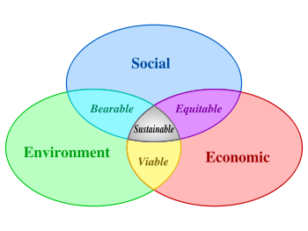
But how do we get there from our current concerns: Sustainable development; a Triple Bottom Line?
That ‘Goldilocks’ zone?
Is this really getting us any closer to sustainability?
Or are we deluding ourselves?
Or merely pandering to business interests with a short-term perspective?

Slide 9
Meantime, in the real world:
environment
society
economy
Any other perspective is scientific nonsense…

Slide 10
How does this matter?
We still frame things too often within an economic model - e.g. the Triple Bottom Line - as if we are beyond natural laws. Regarding ourselves as an integral part of ecosystems is more realistic; and useful…

Slide 11
Question: Which is a natural environment?
…or this; full of human things?
This; devoid of human things?...

Slide 12
Are our structures inherently different from, say, a beaver lodge?

Slide 13
…or a termite mound?
All of us, termites, beavers and humans, use natural resources to create structures that would not otherwise exist…

Slide 14
So, if what we make is not natural, when did we become un-natural?
Here?
What happened?

Slide 15
Human evolution
As a species we evolve with our technology.
This is why most of us now find it easier to survive in downtown Hong Kong than in a forest in NC where we do not know what we can eat and how to stay warm or cool.
We have become dependent on our technology and are evolving with and through our technology.
Think of your relationship with your phone…

Slide 16
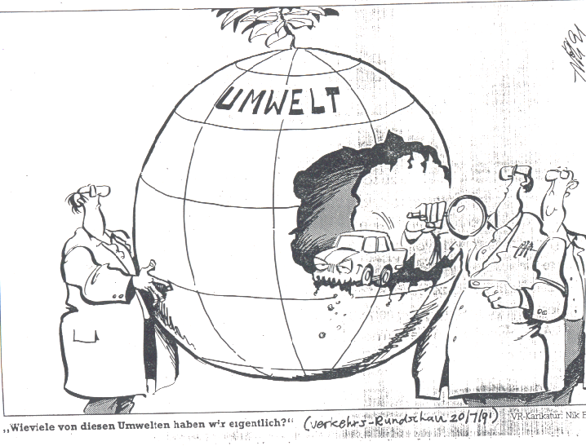
This may be part of the reason why we have come to see the ‘natural’ environment as something separate from us.
environment
How many of these environment things did you say we had?

Slide 17
And now?
More recent thinking (since Darwin?) has once again reinserted us into nature as one of the many species on our planet.
But somehow, what we make has not followed suit - weird.

Slide 18
The distinction between natural and ‘man-made’ is entirely of our own making.

Slide 19
This is therefore a natural object...

Slide 20
Consuming cars

Slide 21
Ford v Sloan
Ford:
“It is considered good manufacturing practice, and not bad ethics, occasionally to change designs so that old models will become obsolete…Our principle of business is precisely the contrary…We want the man who buys one of our products never to have to buy another”
(Henry Ford, 1924, My Life and Work)
Sloan (GM):
“Consumer dissatisfaction with today’s car was engendered by the innovation of the annual model change, which called for major styling revisions every three years, functional or not, with minor annual faceliftings in between.”
(Flink, 1988, The Automobile Age)

Slide 22
Who won?
“…consumers of the 1900s were not born wasteful, they were trained to be so by sales-hungry teachings of a handful of industries bent on market domination.”
(Chapman, 2005)

Slide 23
How does this matter?
Our relationship with cars is a key element in our unsustainability.
Lack of respect for the true value of cars can lead to their overconsumption.

Slide 24
Also: the move to EV: As in-use (well-to-wheel) CO2 emissions come down, embedded emissions rise as a proportion of the total

Slide 25
Durability
If a car lasted longer it would use fewer resources in production.
The impact of disposal and recycling would be reduced.
And in future making the car is where most CO2 emissions will be.
But: Do people want long-life cars?

Slide 26
‘Professionalisation’ of design has taken control away from people
“Modern products demand passive acceptance by the user; there is nothing to be added and contributed by the user. Even the repair of a simple scratch or break is not invited…Thus the user cannot truly ‘own’ the object if he or she cannot engage with it, understand it…or maintain and care for it…this can foster a lack of valuing of the object and lead to its premature disposal…”
(Walker, 2006, 118)

Slide 27
Classic/historic vehicles
Cars become desirable when old.
Owners can make them last long beyond their design life.
Owners are able to retain an emotional link with these cars for many years, even decades.
They often add personal input through restoration, modification or modernisation.

Slide 28
Can we make cars last longer?
cars would have to grow with their owners,
be capable of personalisation and personal input: the‘right to tinker’,
de-professionalise design – this is where more work needs to be done…

Slide 29
Technology may come to the rescue…
IT can be used to reconfigure performance characteristics of cars…
Information sharing: iFixit etc.
Additive manufacturing can be used to personalize cars…
But consumers of automobility would have to learn to engage with their vehicles much more emotionally than they are used to and build a life-long relationship with them.
(see Mitchell, et al. 2010)

Slide 30
Relating to ‘others’
We have created an artificial hierarchy whereby:
Humans are above animals…
Animals above plants…
Animate above inanimate.

Slide 31
Relating to things: Bogost (2012)
Bogost uses: object-oriented ontology (OOO) .
We do not know what it is like to BE an object.
…and objects do not know what it is like to BE us.
…so how do we know we are better than the ‘others’?

Slide 32
A final question: Is our environmental thinking evolving?
Conservationism
Sustainability
The ecological model

Slide 33
The End
Check out:
Nieuwenhuis, P. (2014) Sustainable Automobility; Understanding the Car as a Natural System, Cheltenham: Edward Elgar.
www.sustainableautomobility.com

