Slide 1
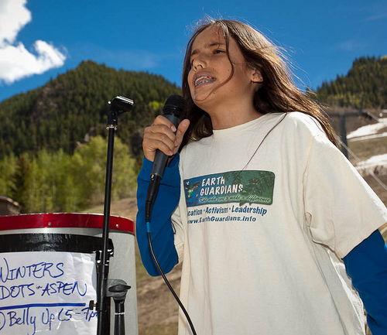
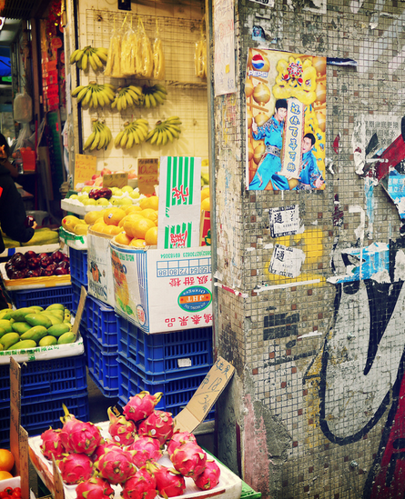
Culture, Carbon, and Climate Change A Class Analysis of Climate Change Belief and Lifestyle Lock-in
Jean Leon Boucher
George Mason University
SCORAI – June 16, 2016

Slide 2
Research Question
Can climate change belief moderate the income-carbon relationship? (lifestyle lock-in; we consume to our income)
Hypothesis? Literature = Don’t think so!
Null
Mixed-method – test (quantitative) and possibly generate theory (qualitative)
DC Climate Activists
Notes:
Be sure to give the rationale for the mixed-method.
A mediator does not influence an existing relationship, but is a variable that forms an indirect relationship.
A moderator influences the relationship between IV and DV

Slide 3
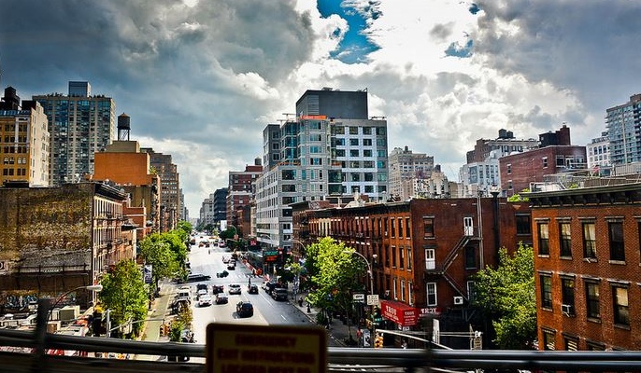
Moving Forward
Only measure mobility-dietary carbon
3 populations
N=2107
N=153
N=28
CC belief is tribal
Notes:
Be sure to give the rationale for the mixed-method.
A mediator does not influence an existing relationship, but is a variable that forms an indirect relationship.
A moderator influences the relationship between IV and DV

Slide 4
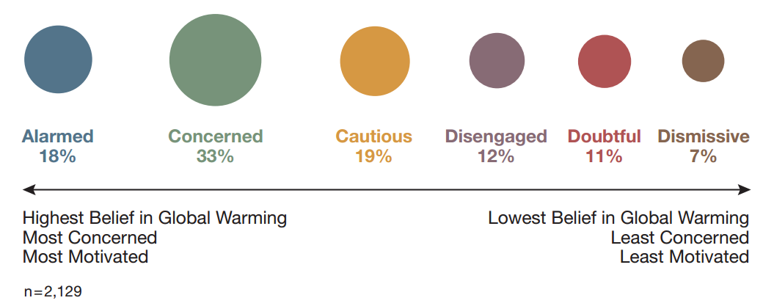
Climate Change in the American Mind: Six Americas Study – USA – Yale/GMU (Leiserowitz et al. 2009)
In response to null hypothesis I sought to interview those with the strongest climate change beliefs

Slide 5
Climate Change in the American Mind: Six Americas Study – USA – Yale/GMU (Leiserowitz et al. 2009)
In response to null hypothesis I sought to interview those with the strongest climate change beliefs

Slide 6
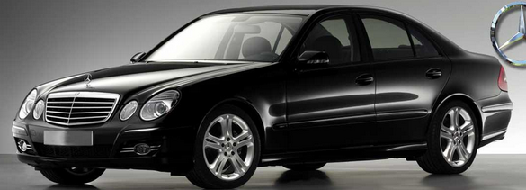
Descriptives Alarmed – Non-Alarmed
More women – (60/40 women vs 50/50)
More educated and more educated census tracts
More liberal
More urban
(all significant differences)
Notes:
I would delete this slide – or move to the end to answer the question should it arise.

Slide 7
Quantitative Findings – Aggregate Footprint National Sample N=2107
(11.8% don’t drive)
(62.8% don’t fly)

Slide 8
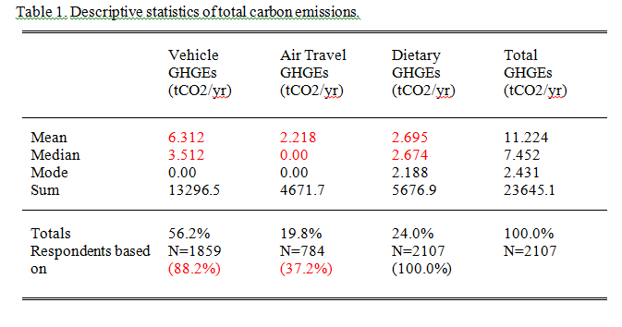
Quantitative Findings - Composition

Slide 9
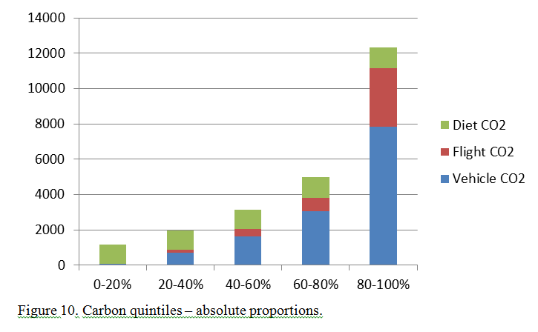
Carbon Quintiles – Total Mobility-Dietary

Slide 10
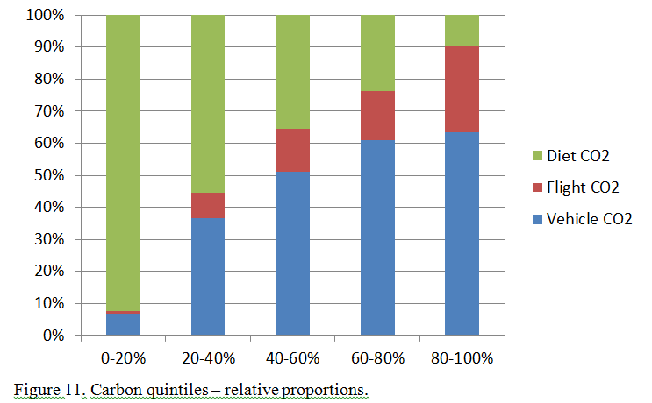
Carbon Quintiles – Relative Proportions

Slide 11
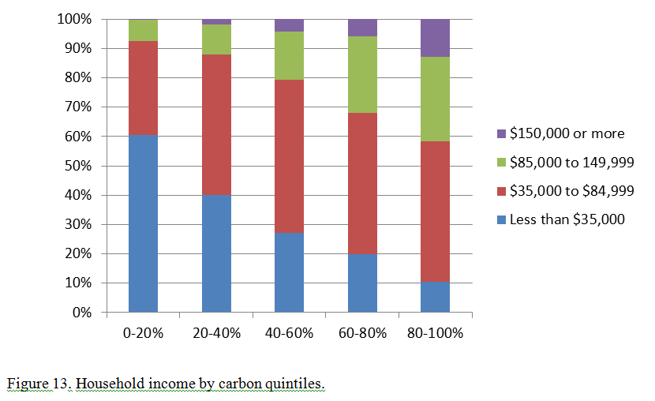
Quintiles and Household Income
R=.280** (.01 level)

Slide 12
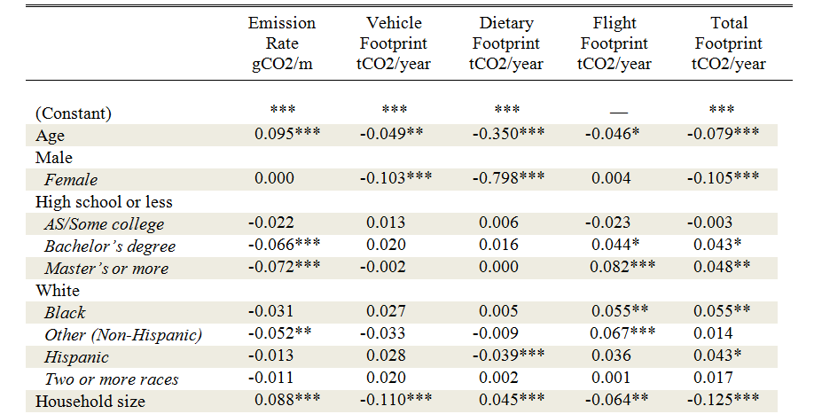
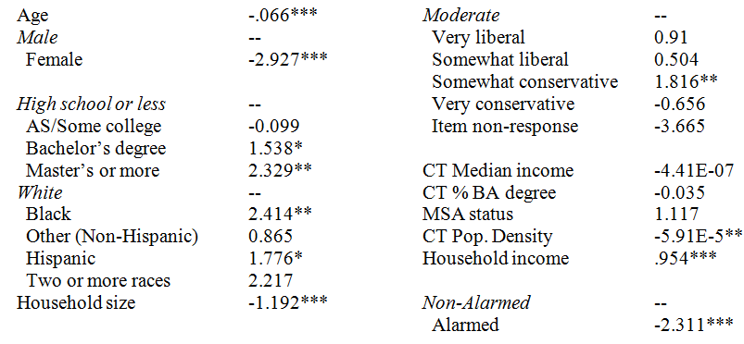
Total Mobility and Dietary Carbon (tCO2/year) All Controlled
Alarmed – Non-Alarmed

Slide 13
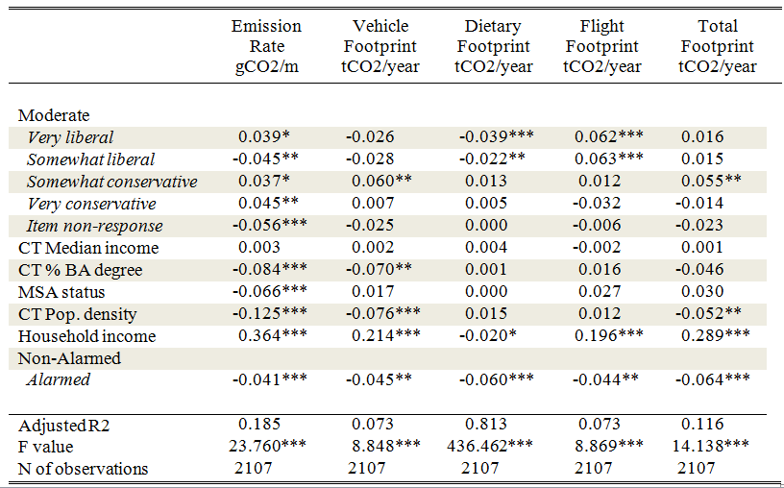
Total Mobility and Dietary Carbon (tCO2/year) All Controlled
4x
Alarmed – Non-Alarmed

Slide 14
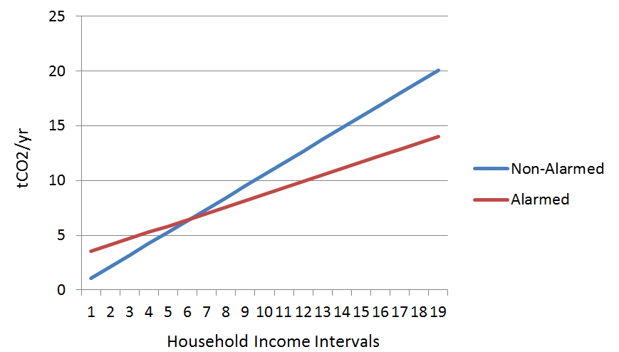
Moderation Effects Income-Belief Interaction (total footprint)

Slide 15
Quantitative - Primary Conclusions
Reject the null hypothesis
18% Alarmed moderate slightly income-carbon relationship
Household income most “predictive” variable 4x
Notes:
I hypothesized a null relationship, but unable to reject
The null hypothesis: there is no difference in CO2 behavior between the Alarmed and the Not Alarmed (controlling for income and other factors) was rejected.

Slide 16
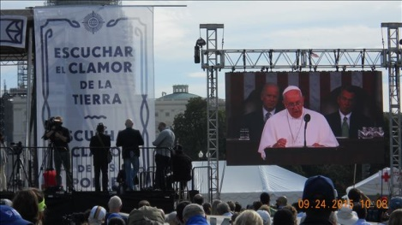
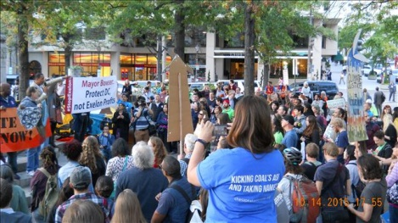
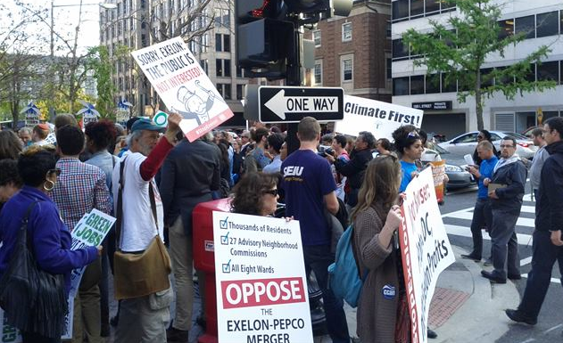
Qualitative Findings How does someone get Alarmed?

Slide 17
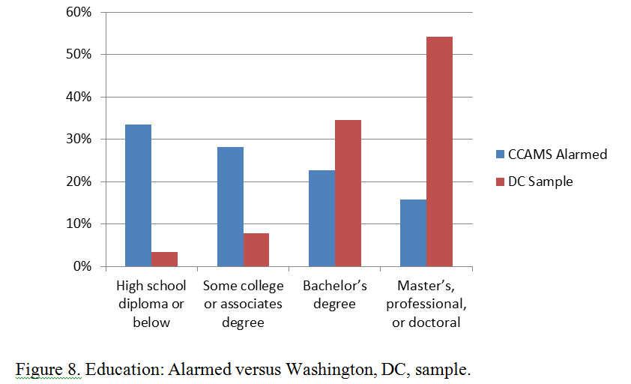
Education National Sample Alarmed (N=380) versus DC sample (N=153)
Notes:
National Sample Alarmed (N=380)

Slide 18
Household Income National Sample Alarmed (N=380) versus DC sample (N=153)

Slide 19
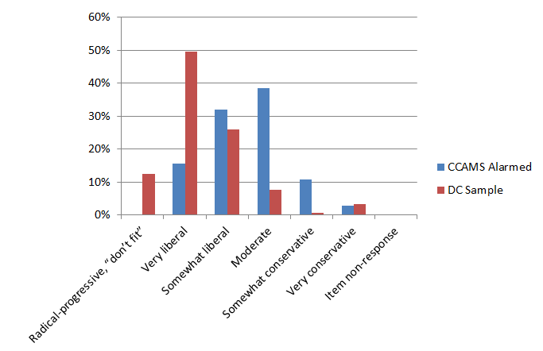
Political Ideology

Slide 20
In-depth Interviews N=28
Most affluent “believers”; over $100,000
¾ live in DC metro area
Median age: 60, but range from 27 to 77
24 of the 28 were partnered (partners matter)
18 managerial/professional occupations; 5 executives (aligns with income and education)
10 Prius owners (some had 2); 3 electric car owners (2 households with 2)
Diets: 21 were omnivores (three without beef), five vegetarians, two vegans.
16 of the 28 were the first-born; 4 of gender

Slide 21
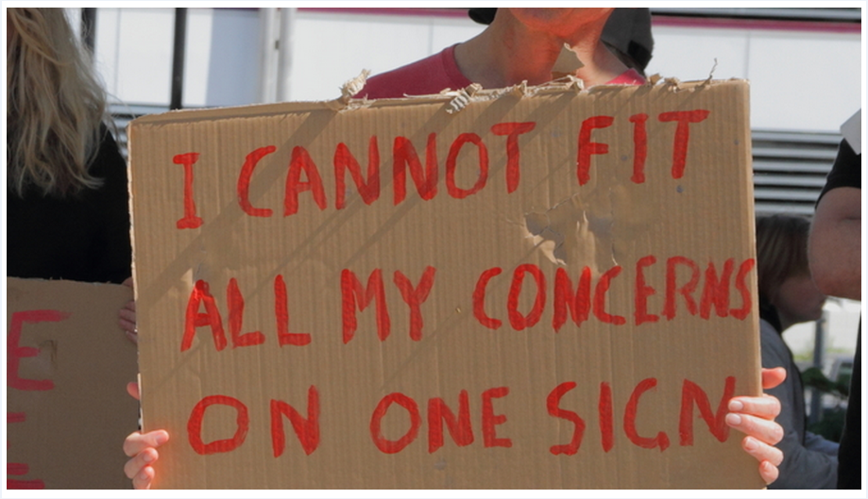
In-depth Interviews N=28
Occupations - Care Worker (60%)
Confirming Altruism: Ability to see beyond self

Slide 22
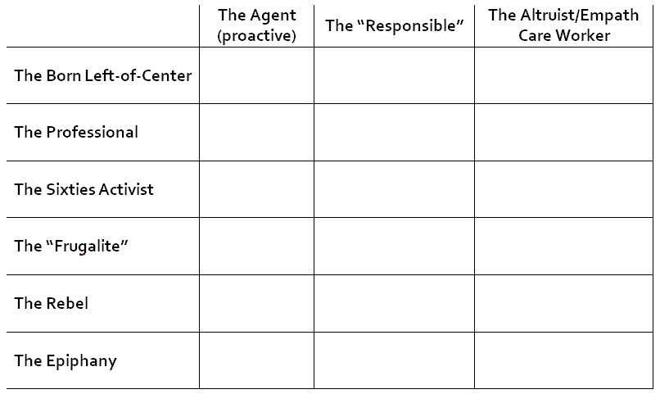
The Interviews (N=28) Master Code: Justice Agent (43 codes reduced)
Cross
Cutting
Themes
Notes:
Edited the slide

Slide 23
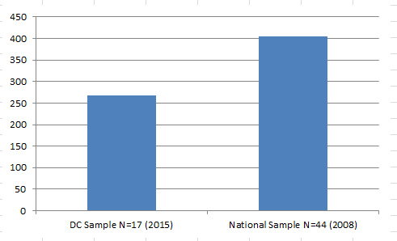
Median Vehicle Emission Rates (g-CO2/m) Alarmed Income of $100,000-$150,000

Slide 24
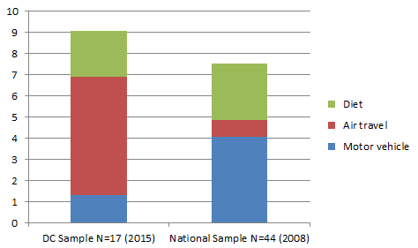
Median Carbon Footprints (tCO2/yr) Alarmed Income of $100,000-$150,000

Slide 25
The Interviews (N=28)
Preexisting cognitive structures
From Left - Justice advocate broadly construed
Comparatively greater number of vegetarians – long timers
Flying seemed part of identity and social “obligations”/constraints
Wont stop visiting son or in-laws each year
Fly overseas every couple years
Some overseas “epiphanies” in younger years

Slide 26
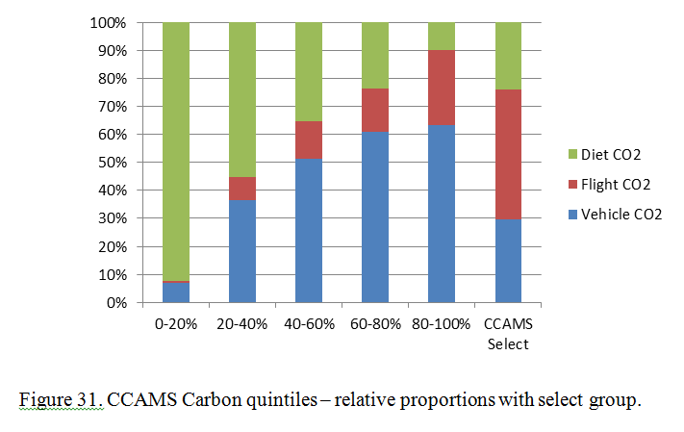
Carbon Quintiles – Relative Proportions
CCAMS Select = Alarmed, White, highly educated, urban liberal (N=12)

Slide 27
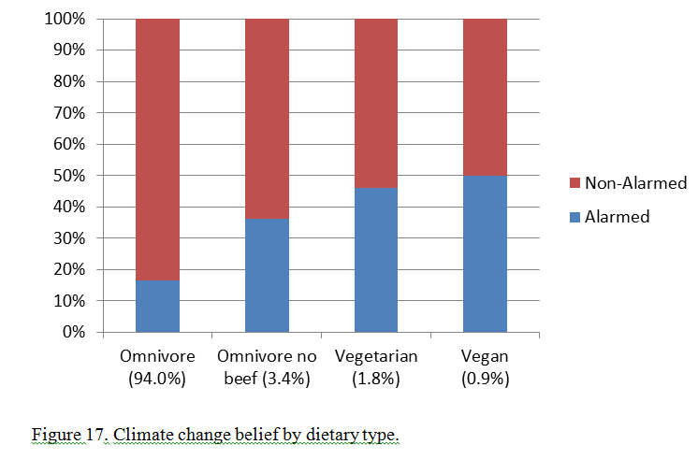
Diets and the Alarmed

Slide 28
Qualitative Insights - Conclusion
Something of a broken carbon conscience for Liberal-Believers? – Internal emissions trading? Needs more research
Qualitative research expanded, highlighted, and offered insights into quantitative data
Can we build on preexisting structures?
Notes:
Try to clarify in the slide and elaborate in conclusions.
Maybe add one more slide putting together the two sets of conclusions.

Slide 29
Policy Recommendations
Limit and tax carbon
Limit and tax income
Tax smaller household sizes
Make carbon socially visible somehow? i.e., Cialdini and Opower – some carbon peer pressure?
But rebound effects?

Slide 30
Thank You

